Slide 1

12:34
12:39
12:49
12:52

Slide 2




Slide 4


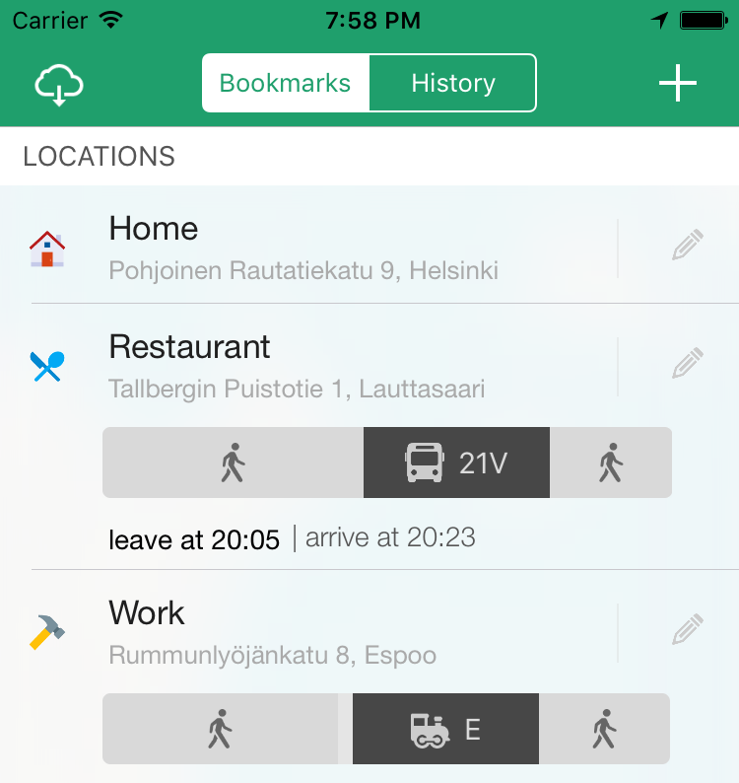

Slide 5



Slide 6








Slide 9


Slide 10
Helsinki 12:30
http://www.fontspace.com/category/thin?p=2
http://www.fontspace.com/nimavisual/trench

Slide 11




Slide 12





Slide 15






Slide 16
M

Slide 17


Slide 18



Slide 19


Slide 20





Slide 21


Slide 26





Slide 27


Slide 28



Slide 39



Slide 40


Slide 41


Slide 42


Slide 45


Slide 46


Slide 47







Slide 48





Slide 49


Ewket Apps
®
Ewket Apps
®

Slide 50










Slide 52




Slide 53


Slide 54



Slide 56

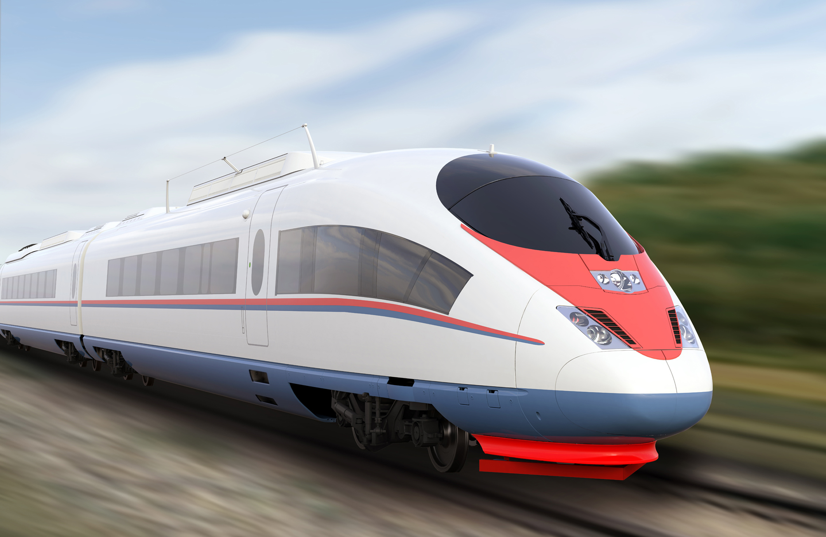

Slide 58
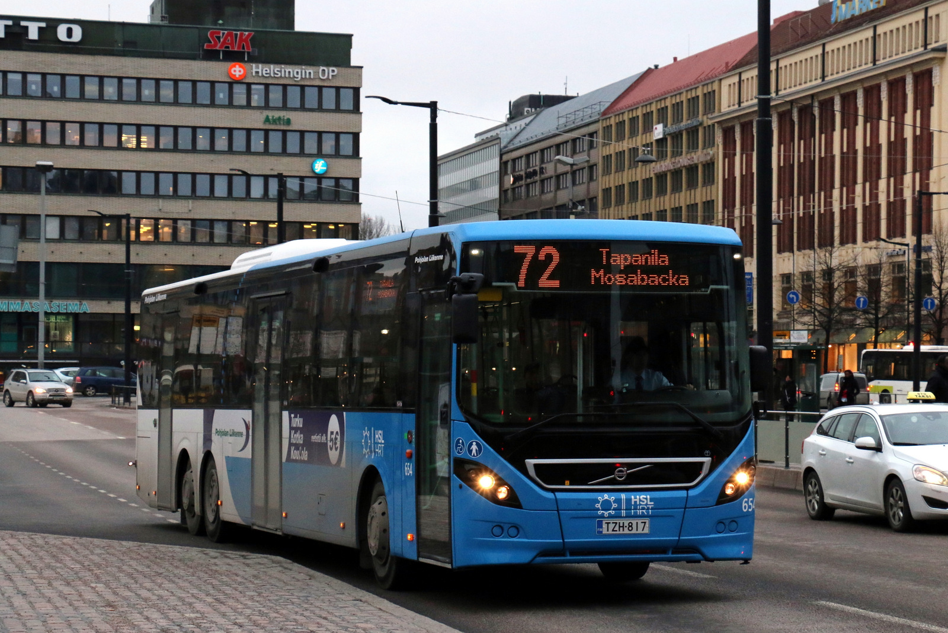

Slide 60


Slide 61
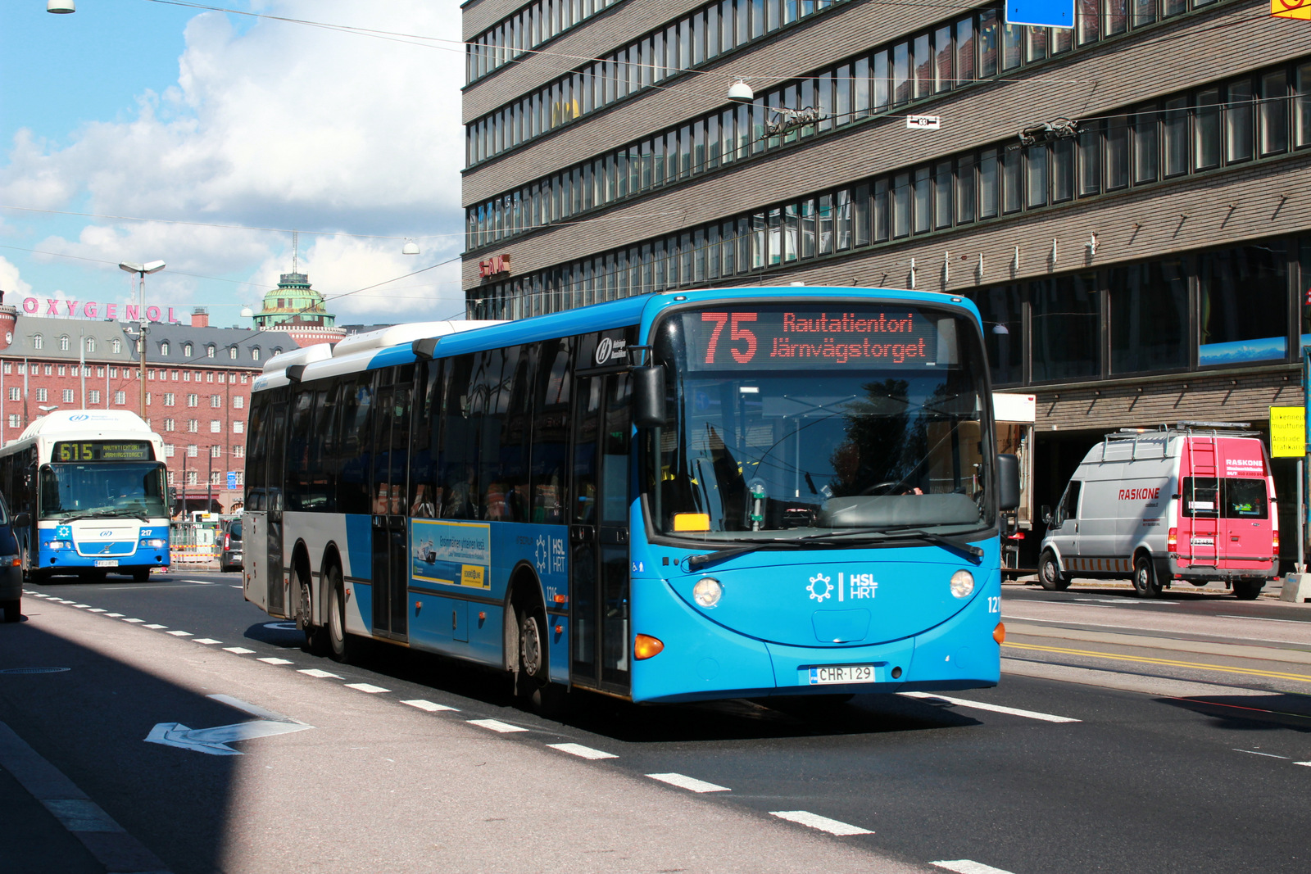

Slide 62


Slide 63


Slide 65
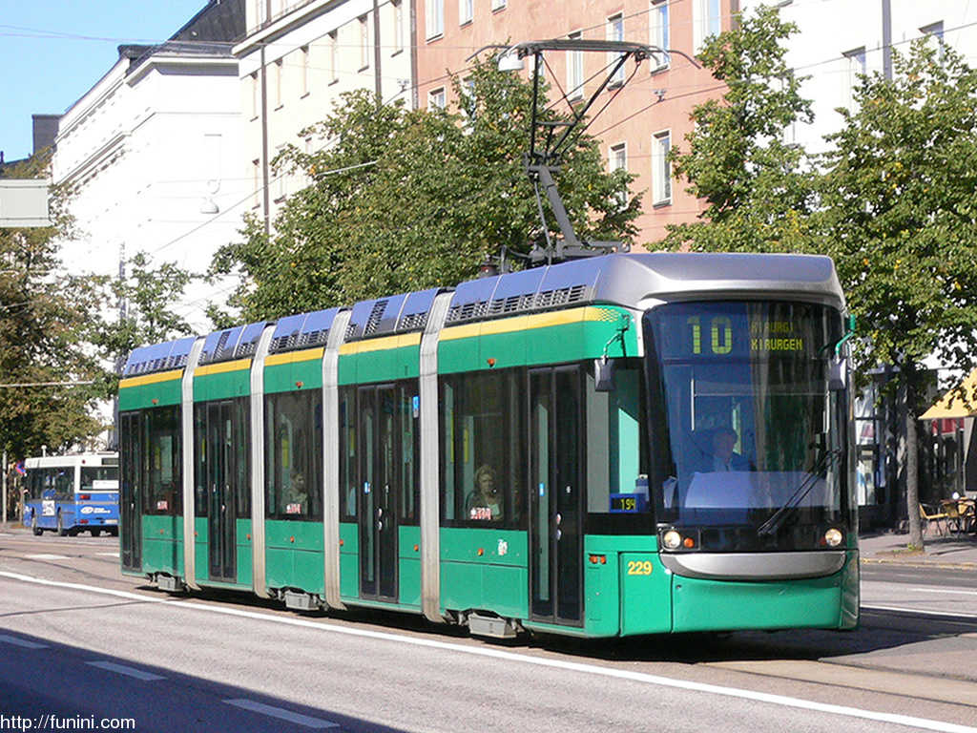

Slide 67


Slide 69
C
B
A - > C
B -> X
X = (b * C)/A
Dif = (A – B)/2
A
C * (1 – B/A)/2

